Slide 1
DSA - 3
Document Similarity Analyzer
Comparing large text documents using suffix structures and similarity metrics
B Haasini Reddy – 2520030265
Arjun Tomar – 2520030285
M Manasa - 2520030500

Slide 2
Problem Statement
Design a document similarity analyzer capable of comparing large text documents using suffix structures and similarity metrics.
The system should identify duplicate or highly similar documents by analyzing common substrings and matching patterns.
It should compute similarity scores and rank documents accordingly.
The solution should efficiently process multiple documents simultaneously.
Useful for plagiarism detection and document clustering applications.
2

Slide 3
Abstract
Large-scale text repositories make manual comparison impractical. This project proposes a similarity-analysis engine that leverages suffix-based data structures — suffix trees and suffix arrays — to index every document once and rapidly discover shared substrings across the entire collection.
Matching patterns are converted into quantitative similarity metrics, producing scores that can be ranked and clustered to reveal duplicate, near-duplicate, and thematically related documents.
Key idea: index once, match fast, score objectively, rank and cluster.
3

Slide 4
How It Works
1
Preprocess — Clean, tokenize, and normalize each incoming document.
2
Build Suffix Structure — Construct a suffix tree / array to index all substrings.
3
Match Patterns — Traverse the structure to find shared substrings across documents.
4
Score Similarity — Convert substring overlap into a normalized similarity score.
5
Rank & Cluster — Sort by score and group closely related documents.
4

Slide 5
Input
Collection of Documents
SCALE
A corpus of large text documents submitted for pairwise comparison.
10,000
Documents may vary in length, topic, structure, and formatting.
documents, maximum
Common formats: plain text, Word, or PDF, normalized to raw text.
Content is analyzed for common substrings and matching patterns.
5

Slide 6
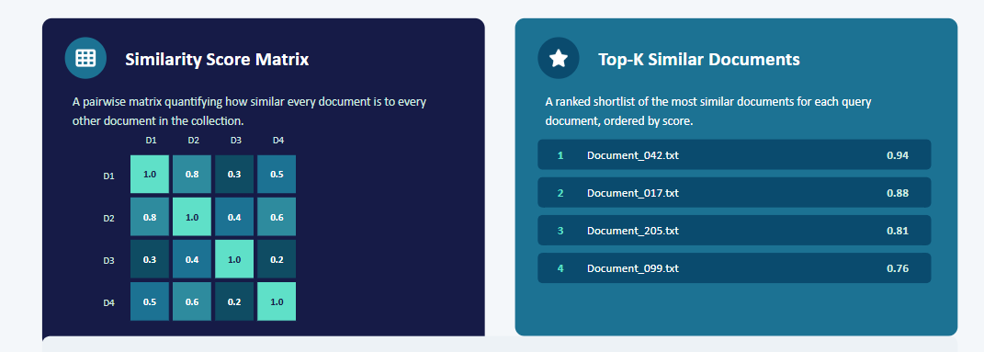
Expected Output
Also included: automatic duplicate flags and cluster groupings for documents above a configurable similarity threshold.
6

Slide 7
Thank You

